Slide 1
Available East Housing Lots
Dozens of sites to choose from
$5,000 each
Lots sizes: approx. 11,000 – 15,000 square feet
Utilities on site (Electric, Sewer, Water)
Protective covenants in place
Lots can be or have been removed from floodplain
Close to Kirkpatrick Memorial Park and Pershing Elementary School
In this packet:
Available Lot Map
Subdivision Maps
Protective Covenants
Floodplain Map
Sewer Depth Layout

Slide 2
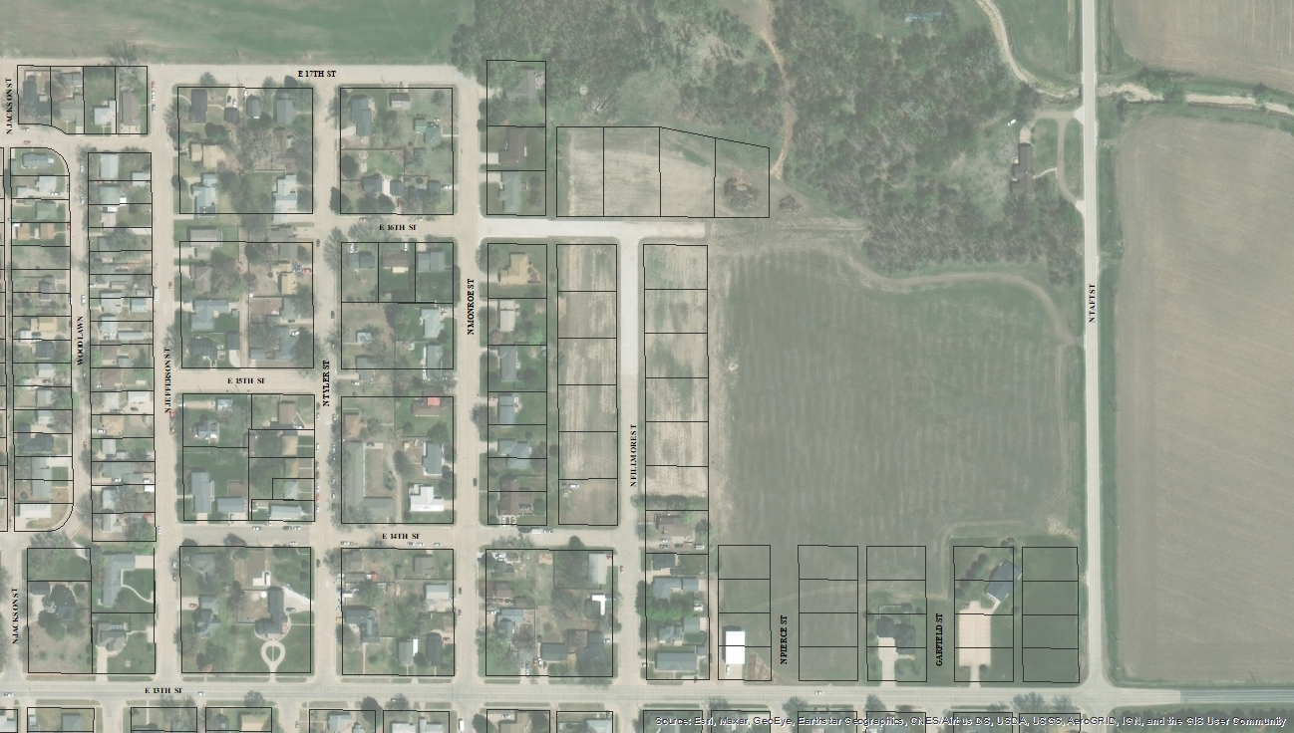
Available Single-Family Housing Lots – Northeast Lexington, NE
Lots Available--$5,000/lot,
build within 12 months
Indicates houses under construction or complete, following underlying aerial map.
2
SOLD

Slide 3
7

Slide 4
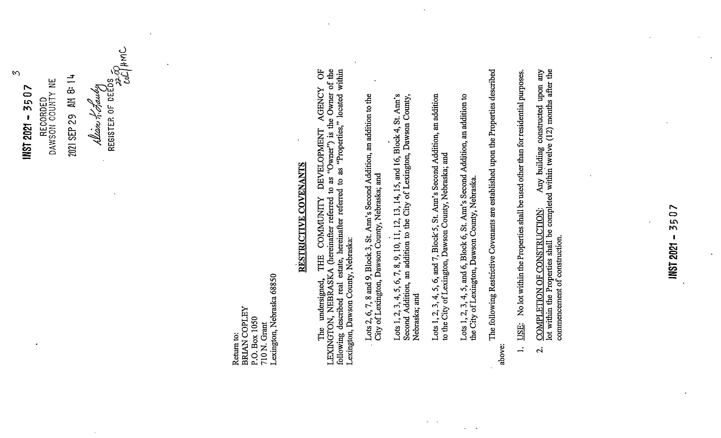
9

Slide 5
10

Slide 6
11

