Slide 1
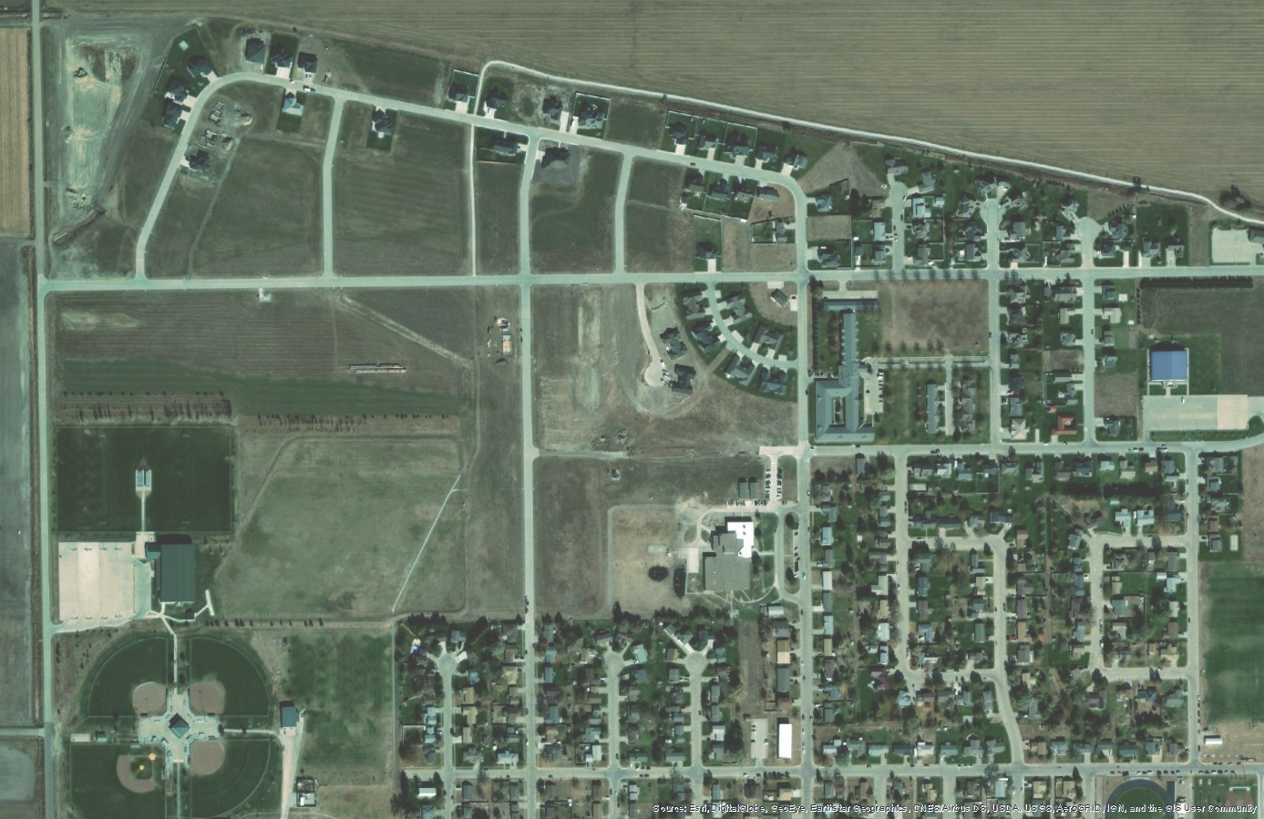
Available Northwest Housing Lots
Dozens of sites to choose from
$0 – $5,000 each
Lots sizes: approx. 12,000 – 25,000 square feet
Utilities on site (Electric, Sewer, Water)
Sewer depths accommodate basements
Protective covenants in place
Lots are not located in floodplain
Close to Optimist Recreation Complex and Sandoz Elementary School
Available Lot Map
Subdivision Maps
Protective Covenants
Floodplain Map
Sewer Depth Layout

Slide 2
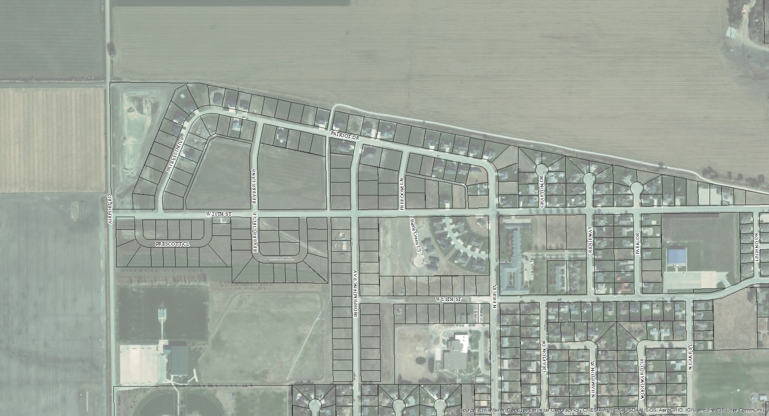
Available Single-Family Housing Lots – Northwest Lexington, NE
Lots Currently
Available – no
Cost, build within
6 months.
Pending
Pending
Pending
Lots Available--$5,000/lot,
build within 12 months
2
SOLD

Slide 3
3

Slide 4
4

Slide 5
5

Slide 6
6

Slide 7
7

Slide 8
Covenants Map
Contact the City of Lexington for a copy of the covenant in each area. An
example is on the following pages.
8

Slide 9
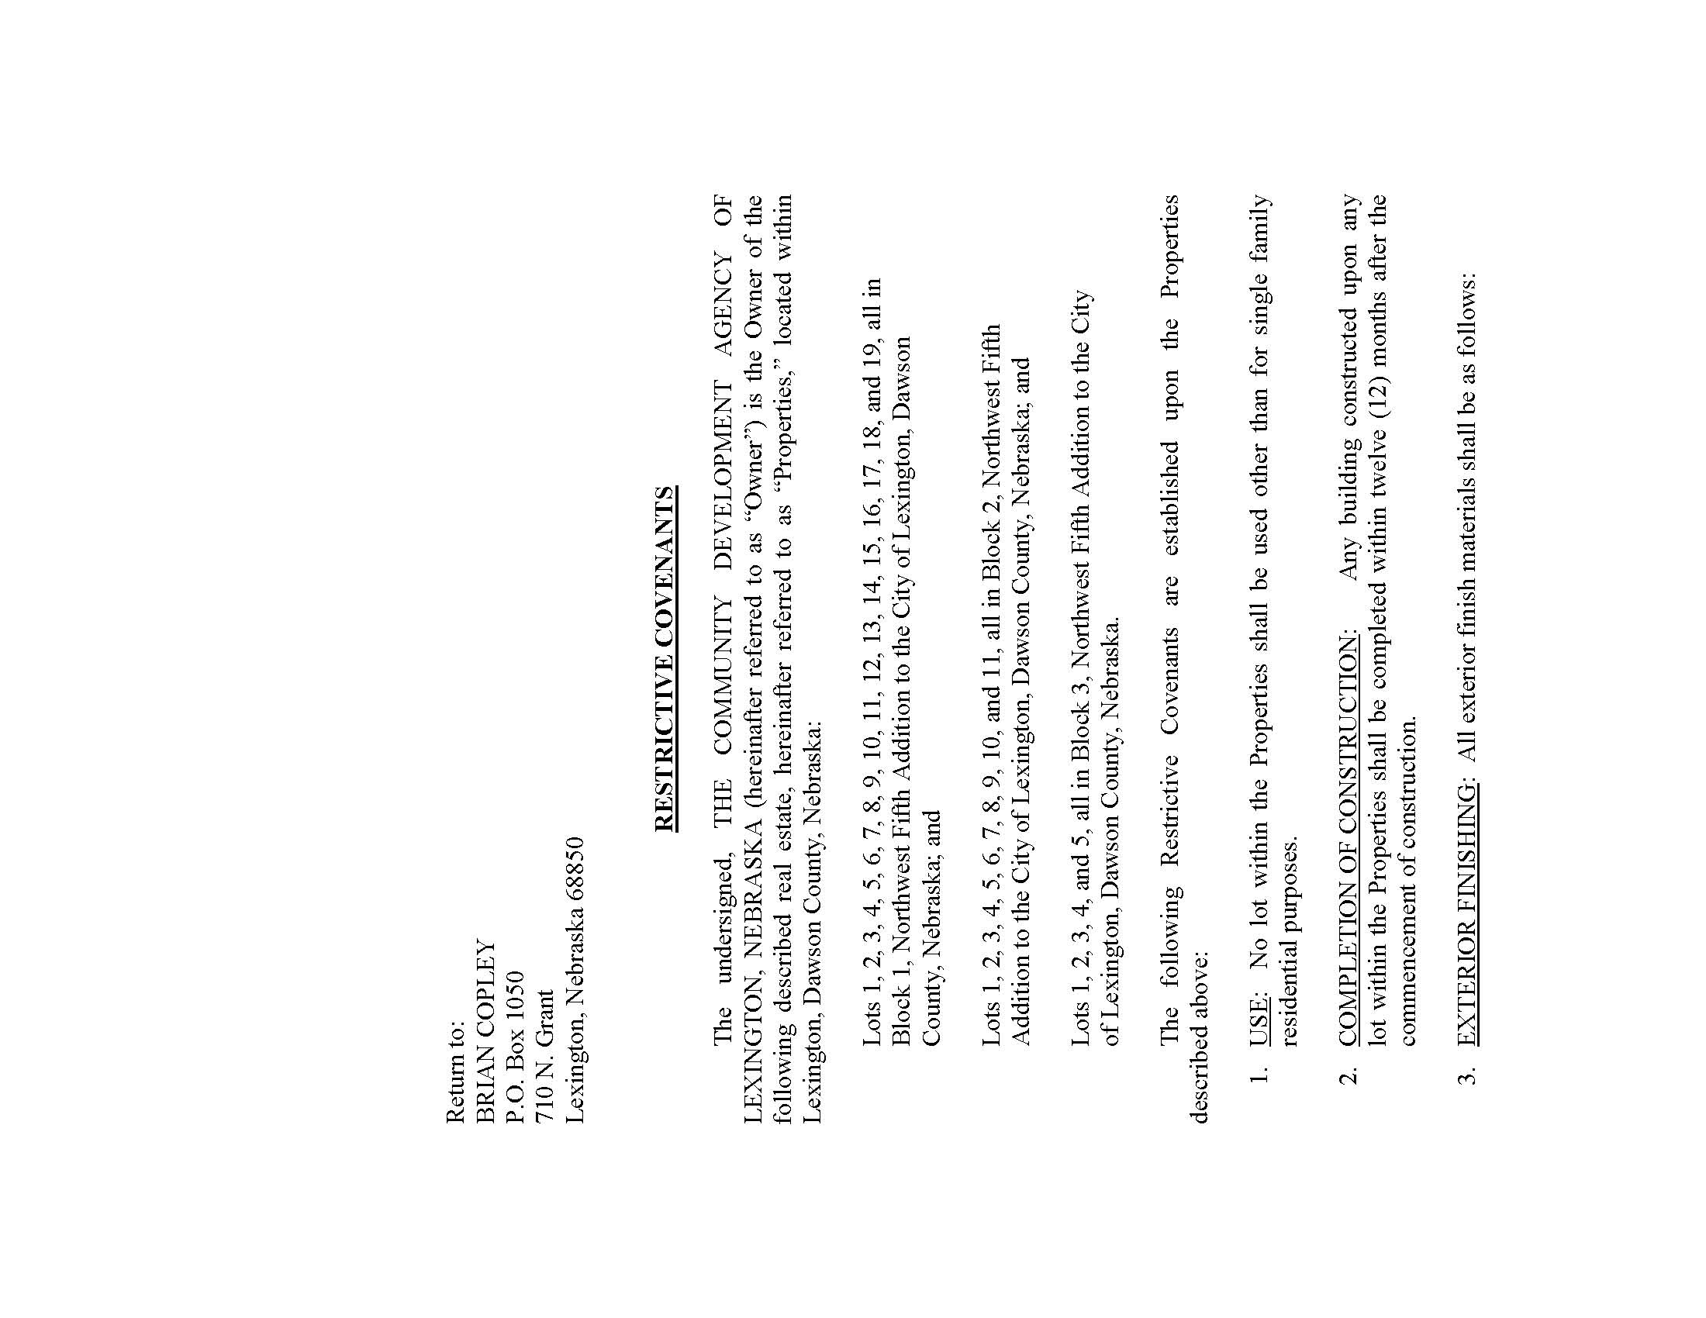
9

Slide 10
10

Slide 11
11

Slide 12
12

Slide 13
13

Slide 14
14

